Slide 1

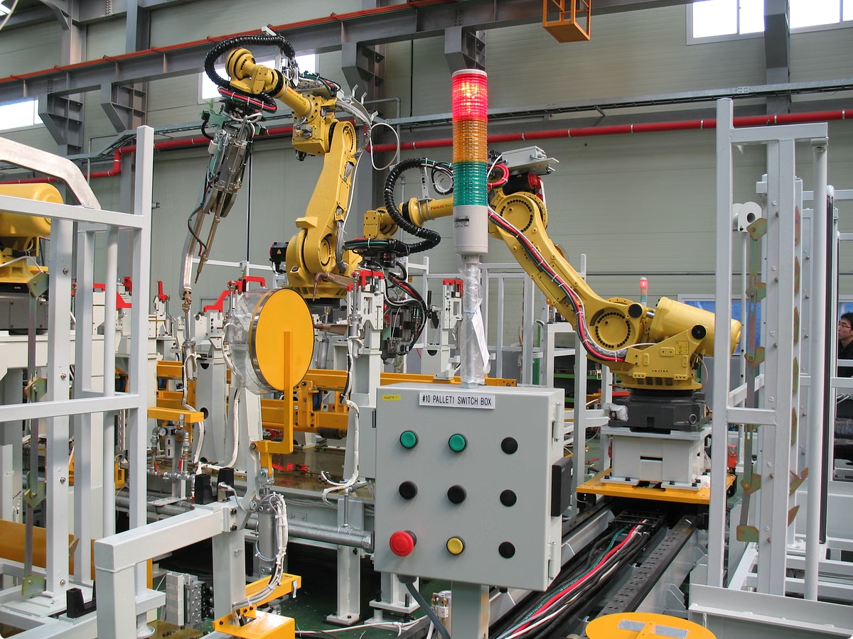
C++ Industrial Equipment Monitoring System
The C++ Industrial Equipment Monitoring System is a sophisticated solution engineered to provide comprehensive insights into the health and performance of machinery within industrial settings.
Submitted by:
G Karthik Reddy (192211751)
S Govardhan (192211491)

Slide 2
Importance of Predictive Maintenance in Industrial Settings
1
Reduced Downtime
2
Enhanced Safety
Predictive maintenance, a core function of this system, empowers businesses to anticipate and address potential equipment failures before they occur, significantly reducing downtime and associated production losses.
Early detection of equipment issues also plays a crucial role in enhancing safety, preventing accidents caused by malfunctioning machinery, and protecting workers from potential hazards.
3
Optimized Maintenance Costs
4
Improved Asset Lifespan
By scheduling maintenance proactively based on real-time data analysis, businesses can optimize maintenance costs, eliminating unnecessary interventions and ensuring repairs are performed only when truly required.
Predictive maintenance strategies contribute to extending the operational lifespan of industrial equipment by identifying and addressing wear and tear before it escalates into critical failures.

Slide 3
Key Components of the Monitoring System
Sensors and Data Acquisition
Data Processing and Analysis
User Interface and Reporting
The system relies on a network of diverse sensors, strategically placed to gather real-time data on critical parameters like temperature, vibration, pressure, and operational hours.
The collected data is then processed and analyzed using sophisticated algorithms and machine learning techniques to identify patterns, anomalies, and potential issues within the equipment.
A user-friendly interface and comprehensive reporting tools provide insights into equipment health, performance trends, and potential risks, enabling informed decision-making.

Slide 4


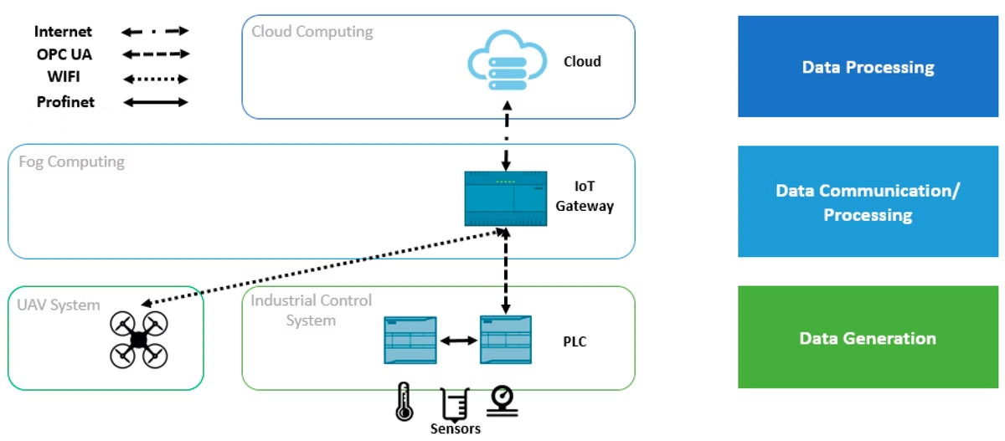


Real-Time Data Collection from Sensors
Sensor Integration
The system seamlessly integrates with a wide range of sensors, including temperature sensors, vibration sensors, pressure sensors, and flow sensors, allowing for the collection of data on various critical parameters.
Data Transmission
Data is transmitted wirelessly or via wired connections to the central processing unit, ensuring rapid and reliable data flow for real-time analysis.
Data Validation and Filtering
Robust data validation and filtering mechanisms are employed to ensure data accuracy and remove spurious readings, ensuring that only reliable data is utilized for analysis.

Slide 5

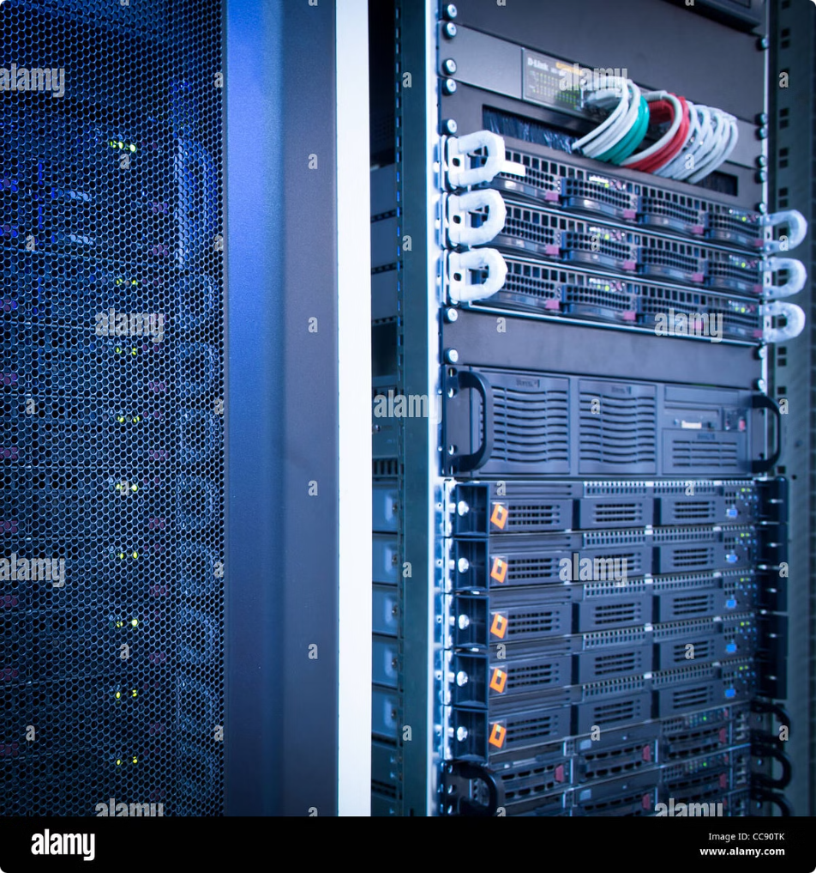
Data Aggregation and Storage
Data Storage
The system utilizes highly efficient databases to store vast quantities of real-time data, facilitating historical analysis and trend identification.
Data Aggregation
Raw data from sensors is aggregated and organized into meaningful metrics, such as average temperature, peak vibration levels, and operational hours, simplifying analysis and reporting.
Data Security
Robust security measures are implemented to protect sensitive data from unauthorized access, ensuring data integrity and confidentiality.

Slide 6

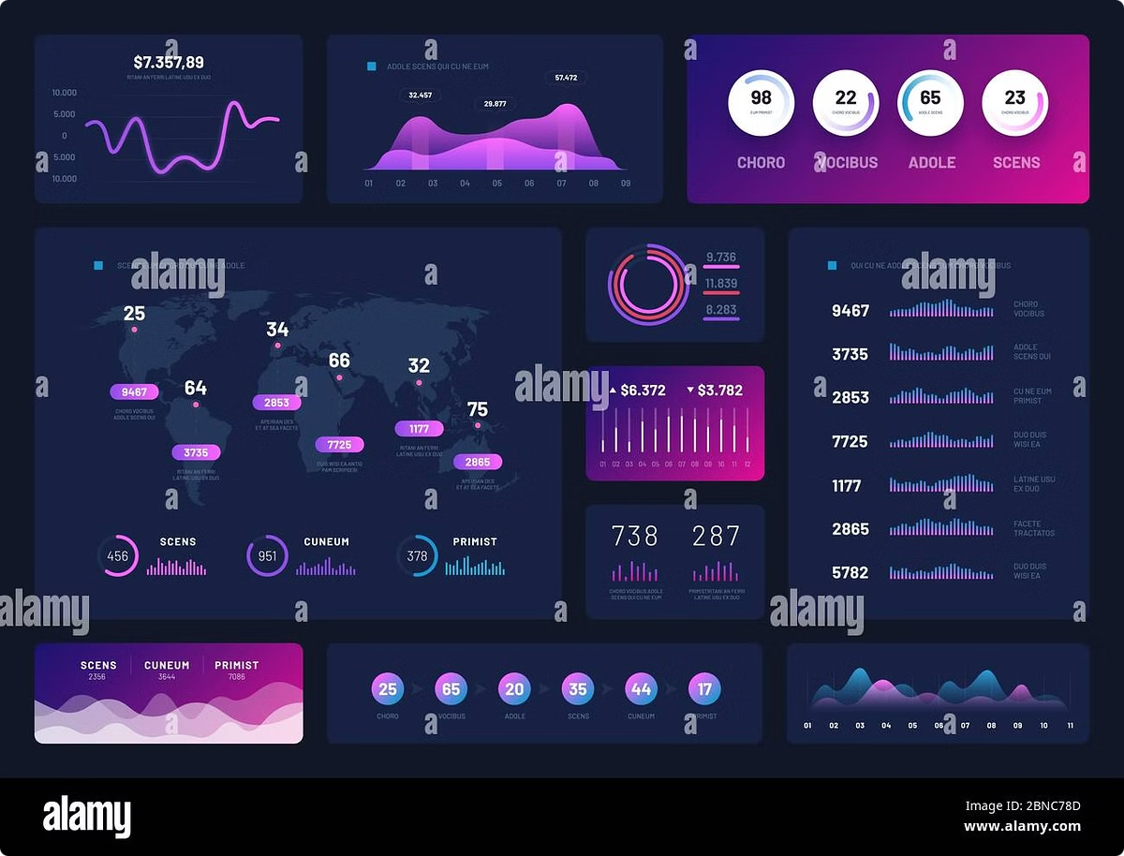
Analyzing Equipment Performance Trends
1
Trend Analysis
The system leverages advanced analytical techniques to identify trends and patterns within the collected data, revealing gradual changes in equipment performance over time.
2
Anomaly Detection
Machine learning algorithms are employed to detect anomalies and deviations from expected performance patterns, flagging potential issues that require attention.
3
Predictive Modeling
Based on historical data and identified trends, the system can generate predictive models to forecast future equipment performance and potential failure points.

Slide 7





Proactive Fault Detection and Alerts
Real-Time Alerts
The system can send real-time alerts to designated personnel when critical thresholds are exceeded, indicating potential failures and requiring immediate action.
Automated Notifications
Automated notifications can be sent via email, SMS, or integrated communication platforms, ensuring prompt notification of issues to the relevant stakeholders.
Fault Diagnosis
The system can provide preliminary fault diagnosis based on collected data, assisting technicians in identifying potential causes of failures and streamlining troubleshooting efforts.

Slide 8


Optimizing Maintenance Schedules
Condition-Based Maintenance
Reduced Maintenance Costs
The system enables condition-based maintenance, scheduling maintenance interventions based on real-time data analysis and equipment health, rather than fixed schedules.
By eliminating unnecessary maintenance interventions and performing repairs only when truly required, the system significantly reduces overall maintenance costs.
Increased Equipment Availability
Proactive maintenance ensures that equipment is operating at optimal levels, minimizing downtime and maximizing equipment availability for production.

Slide 9

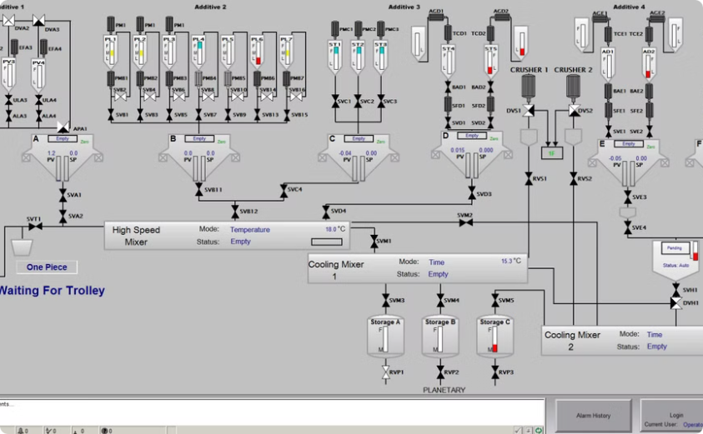
Integrating with ERP and SCADA Systems
Enterprise Resource Planning (ERP)
Supervisory Control and Data Acquisition (SCADA)
Integration with ERP systems allows for seamless data flow between the monitoring system and other enterprise-level systems, enhancing overall business intelligence and decision-making.
Integration with SCADA systems enables the monitoring system to interact with other industrial control systems, providing a unified platform for managing and controlling industrial processes.

Slide 10

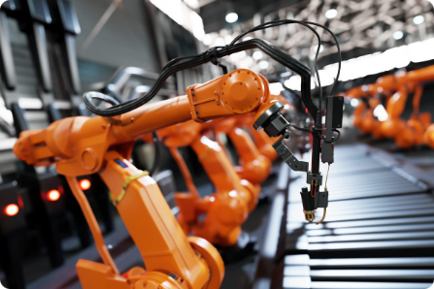
Benefits and Future Enhancements
The C++ Industrial Equipment Monitoring System offers numerous benefits, including reduced downtime, enhanced safety, optimized maintenance costs, and improved asset lifespan. Future enhancements may include the integration of artificial intelligence (AI) for more sophisticated fault prediction and diagnosis, as well as the development of augmented reality (AR) interfaces for intuitive equipment visualization and remote troubleshooting.

